Slide 1
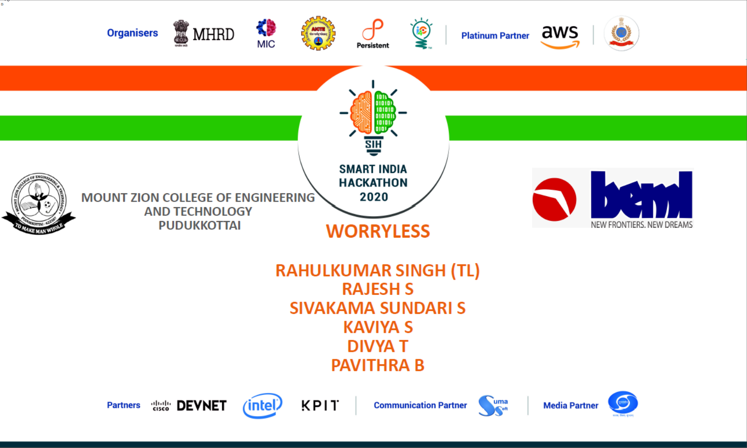

Slide 2
BH60M & BH100 with Electronic Transmission
Securing the CAN J1939 2.0B Communication Protocol, to make RIDES SAFER!

Slide 3
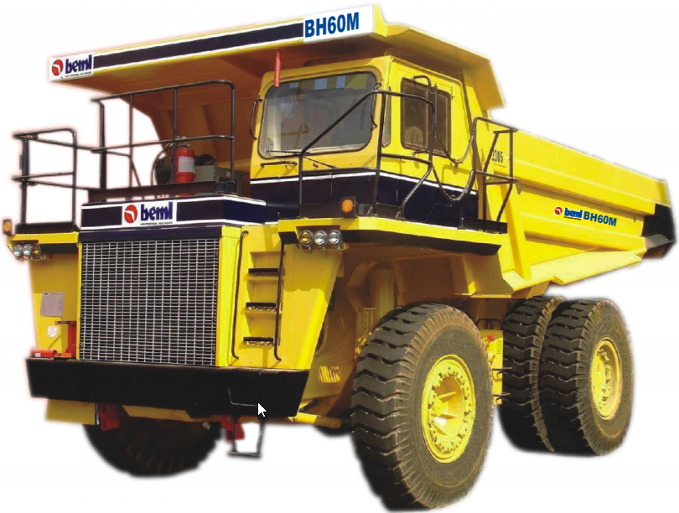
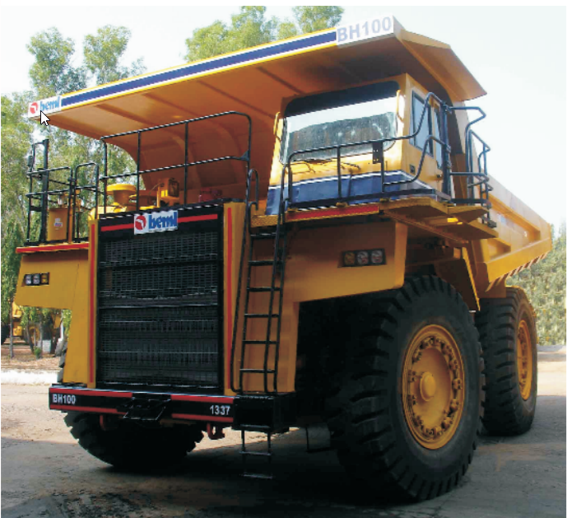
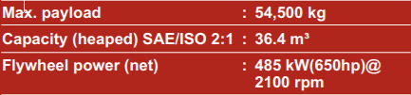
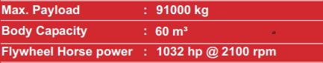

Slide 4
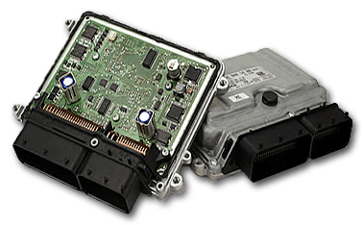
Description of the Problem
The ECUs
Electronic Control Units (ECUs) embedded in engine, transmission.
ECUs used for monitoring, display, store, control application.
ECUs are PROGRAMMABLE, hence VULNERABLE.

Slide 5
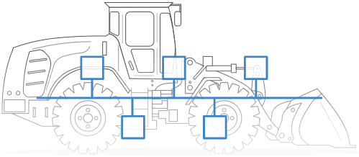
Description of the Problem
CAN J1939 2.0B
ECUs sends vital/critical data over CAN J1939 2.0B communication protocol.
CAN bus : Protocol that allows devices to communicate with each other in a vehicle.
SAE J1939 : Set of standards that define how ECUs communicate via the CAN bus in heavy duty vehicles.

Slide 6
Objective of the Project
Unauthorised access and manipulation of the CAN J1939 2.0B bus.
Unauthorised access and manipulation of the ECUs.
Implementation of Security measures.

Slide 7
Project Life Cycle
04
Unauthorised Access
Implement Security
We implement security measures.
We try to gain unauthorised access of CAN bus and ECUs.
01
03
Reverse Engineering
Attack
We reverse engineer our findings.
Based on the data we have, we manipulate the victim vehicle.
02

Slide 8
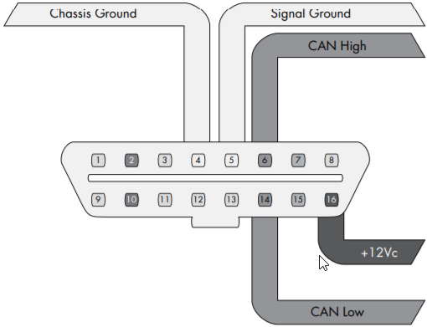
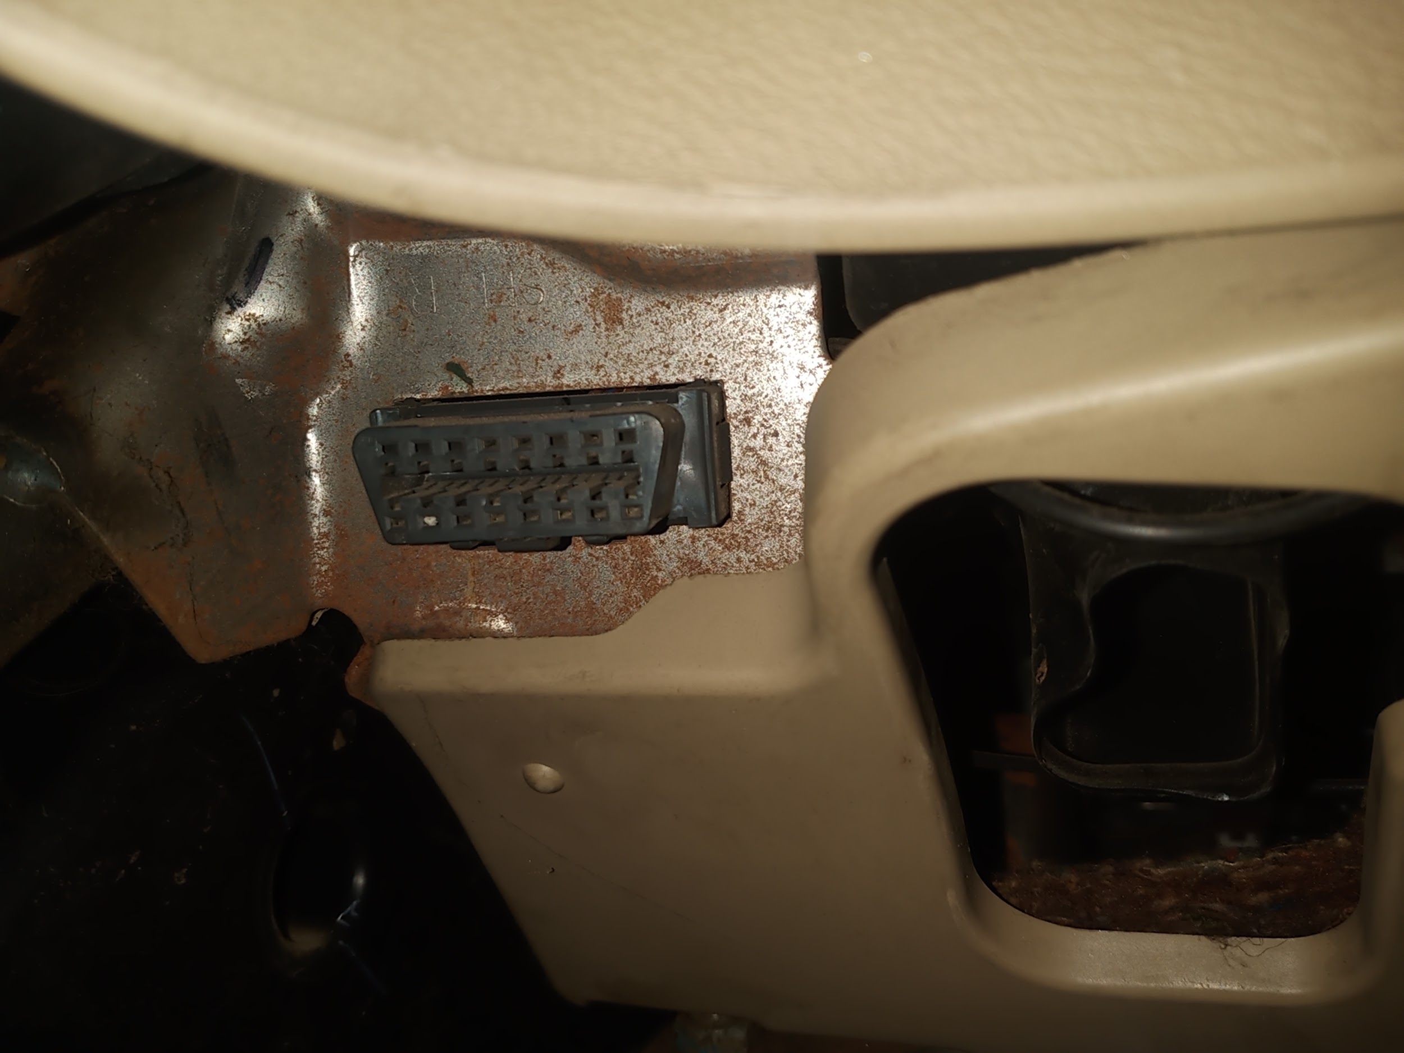
Unauthorised access and Manipulation of the CAN J1939 2.0B bus
01
Gaining Unauthorised Access and Retrieving Data:
Through OBD2 port (Opted to use)
Ripping off the CAN bus wires
Through the termination end
Remotely
OBD2 Port
OBD2 Port in our Demo Vehicle

Slide 9
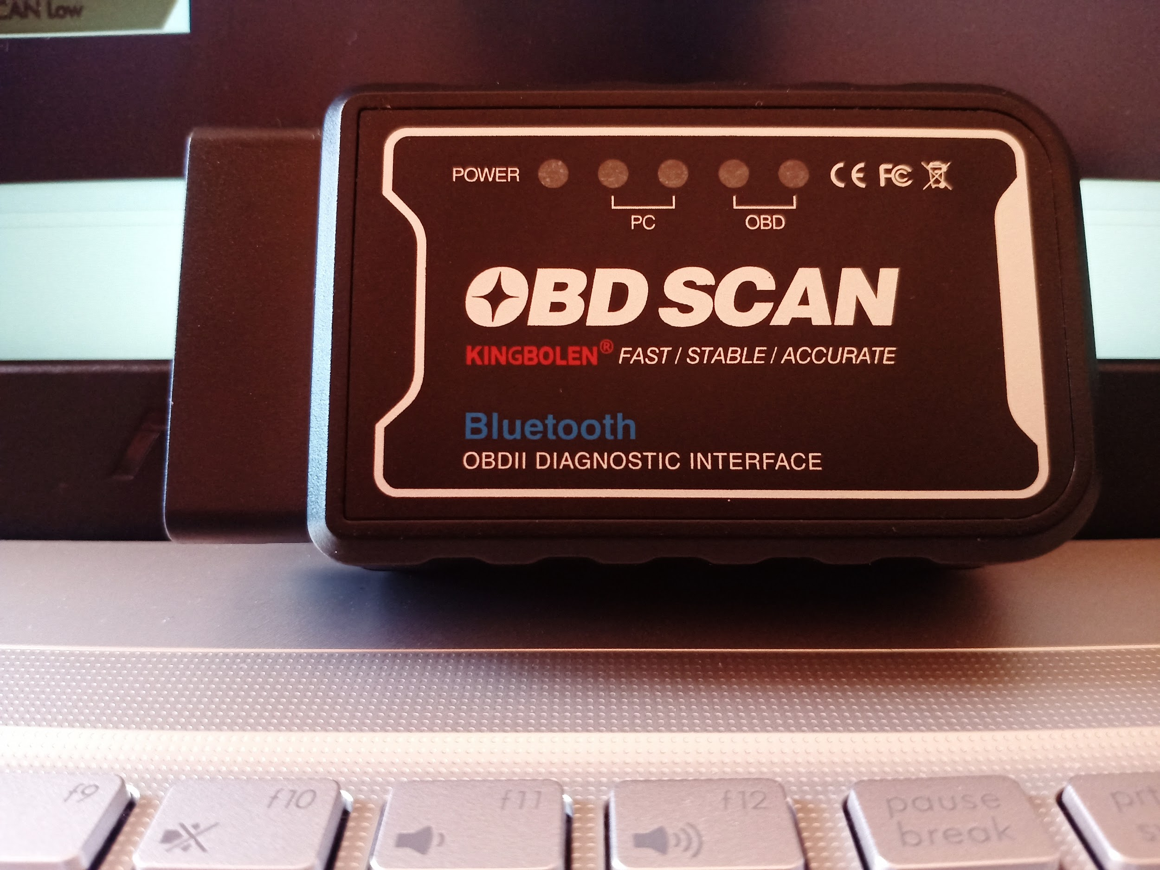

Unauthorised access and Manipulation of the CAN J1939 2.0B bus
01
Gaining Unauthorised Access and Retrieving Data:
OBD2 Port Bluetooth Adapter
Live Simulation Video

Slide 10
Unauthorised access and Manipulation of the CAN J1939 2.0B bus
02
Reverse Engineering: Using Asammdf 5.19.3
CAN J1939 2.0B Raw Data
Reverse Engineered using J1939 DBC

Slide 11
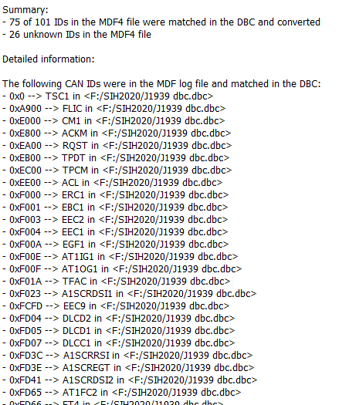
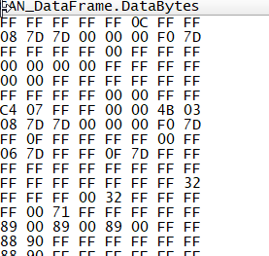
Unauthorised access and Manipulation of the CAN J1939 2.0B bus
03
Altering CAN Data and Manipulating the Vehicle.

Slide 12
Unauthorised Access and Manipulation of the ECUs.
Various Methods:
Front Door Attack
Back Door Attack
Exploits
Reversing Automotive Firmware

Slide 13
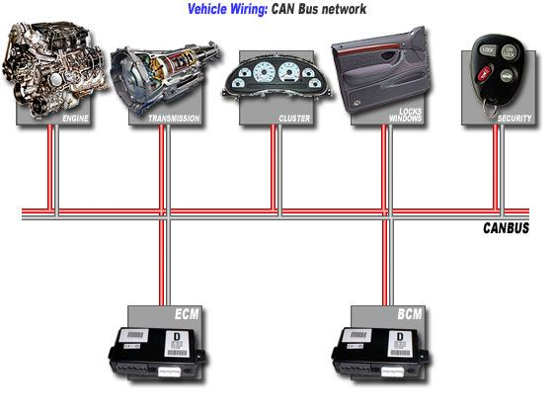
Implementation of Security measures.
Network Segmentation:
All ECUs are connected serially with CAN bus.
Once hacked, all devices are vulnerable.
Network Segmentation prevents it.
R&S
R&S
R&S
BEFORE
AFTER

Slide 14


Implementation of Security measures.
Encryption and Decryption
Develop own simple yet strong encryption - decryption algorithm
Make sure, speed of the transmission is not compromised
Encryption
#06F – 87AB - 1233
KHJDFHADSJFKHJD
Raw CAN J1939 2.0B Data
Encryption Key
Algorithm
Cipher text
Decryption
KHJDFHADSJFKHJD
#06F – 87AB - 1233
Raw CAN J1939 2.0B Data
Decryption Key
Algorithm
Cipher text

Slide 15


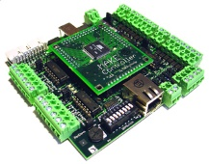
Implementation of Security measures.
Proxy and Firewall:
Develop own mechanism that identifies foreign device.
Deny service to foreign devices and alert when network is manipulated.
Foreign Device
Inside the Vehicle
Firewall & Proxy
Deny Service and Alert

Slide 16

Outcome
Know all the possibilities of hacking into a vehicle.
Implement security measures with respect to hacking techniques.
Avoid intentional accidents.
Makes rides safer, mentally as well as physically.
Avoids data theft.

Slide 17
Implementation of Security measures.
Proxy and Firewall:
Develop own mechanism that identifies foreign device.
Deny service to foreign devices and alert when network is manipulated.
Foreign Device
Inside the Vehicle
Firewall & Proxy
Deny Service and Alert

Slide 18
Conclusion
As we know, Nothing on Earth is Perfect!
Though our project might not be perfect, but it would surely make
COMPANY HAPPY :)
RIDERS HAPPY :)
HACKER SAD ;(

Slide 19
THANK YOU

Slide 21
BH60M & BH100 with Electronic Transmission
Securing the CAN J1939 2.0B Communication Protocol, to make RIDES SAFER!

Slide 22

Hacking http://rnddev.azurewebsites.net/
Stages of Hacking:
The stages depicted below in the image will be the stages taken by us as a hacker to exploit http://rnddev.azurewebsites.net/
Enumeration

Slide 23
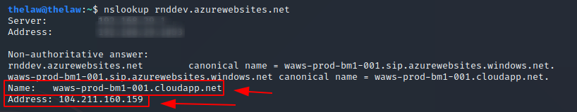
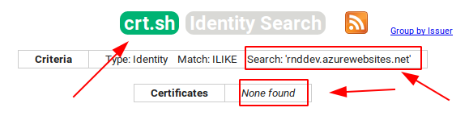
Hacking http://rnddev.azurewebsites.net/
Reconnaissance: Passive Recon & Active Recon
IPv4 identification using nslookup:
Identifying other domain linked to rnddev.azurewebsites.net using crt.sh tool: (Didn’t find any)

Slide 24
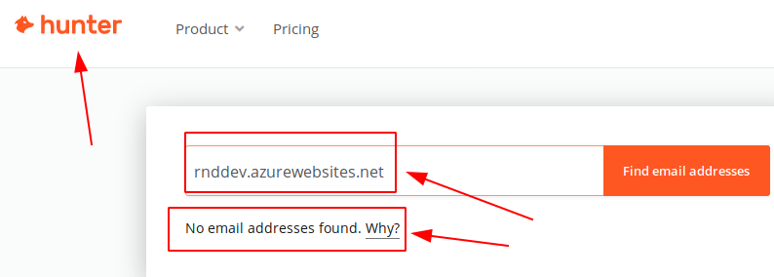
Hacking http://rnddev.azurewebsites.net/
Reconnaissance: Passive Recon & Active Recon
Identifying any email address with the above domain using hunter.io tool: (Didn’t find any)

Slide 25
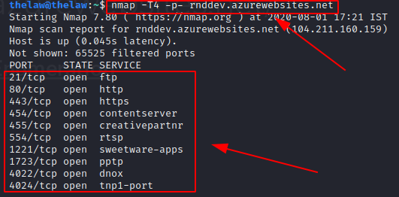
Hacking http://rnddev.azurewebsites.net/
Scanning and Enumeration
Scan which ports are empty using nmap tool:
From hacker point of view, the above findings will be very crucial during exploitation process. Open ports are like gems for hackers if they are not patched.

Slide 26
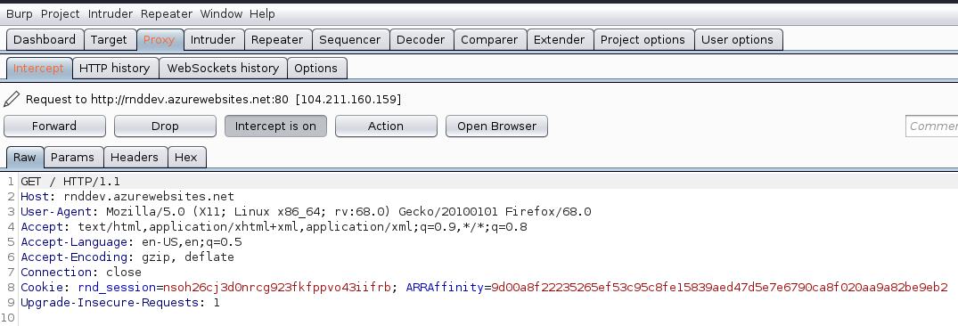
Hacking http://rnddev.azurewebsites.net/
Scanning and Enumeration
Intercepting request using BurpSuite tool:

Slide 27
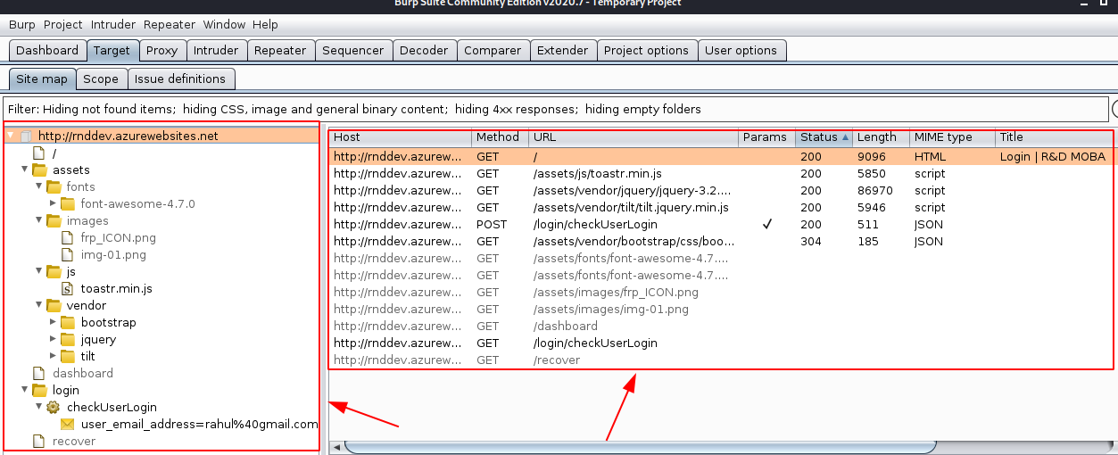
Hacking http://rnddev.azurewebsites.net/
Scanning and Enumeration
Finding directories using BurpSuite tool:

Slide 28
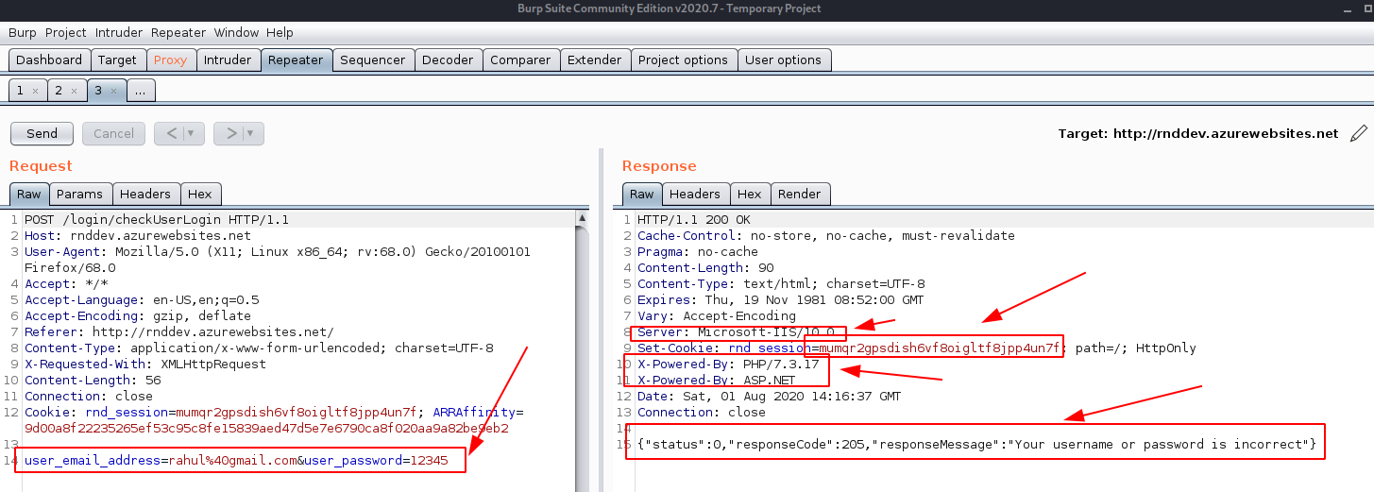
Hacking http://rnddev.azurewebsites.net/
Scanning and Enumeration
Checking for information disclosure using BurpSuite tool:
Information about server and the website is disclosed. Error messages might disclose if SQL Injection is possible.

Slide 29
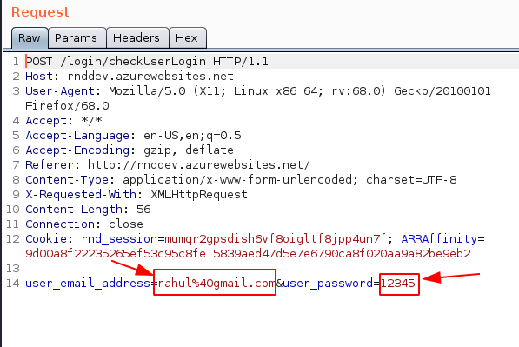
Hacking http://rnddev.azurewebsites.net/
Scanning and Enumeration
Understanding based on previous findings in BurpSuite tool:
Using Intruder option in BurpSuite, Sniper Attack can be performed in the input fields.

Slide 30
Hacking http://rnddev.azurewebsites.net/
Scanning and Enumeration
Understanding based on previous findings in BurpSuite tool:
Using Intruder option in BurpSuite, Sniper Attack can be performed in the input fields.

Slide 31
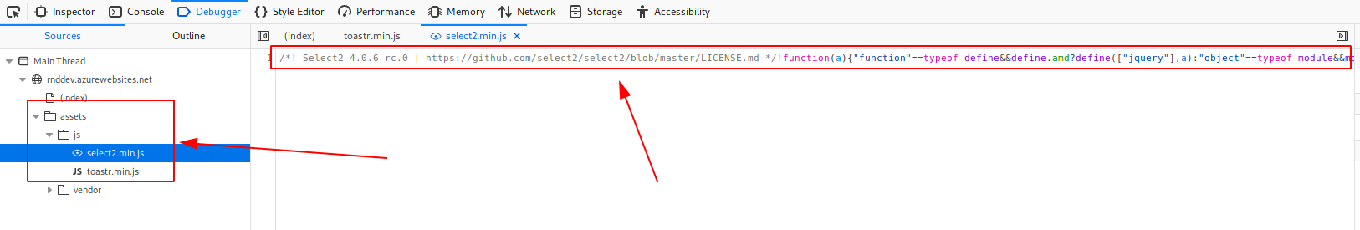
Hacking http://rnddev.azurewebsites.net/
Scanning and Enumeration
Using Inspect Element option in the browser:
The Javascript files might become handy, during exploitation stage.

Slide 33
BH60M & BH100 with Electronic Transmission
Securing the CAN J1939 2.0B Communication Protocol, to make RIDES SAFER!

Slide 34
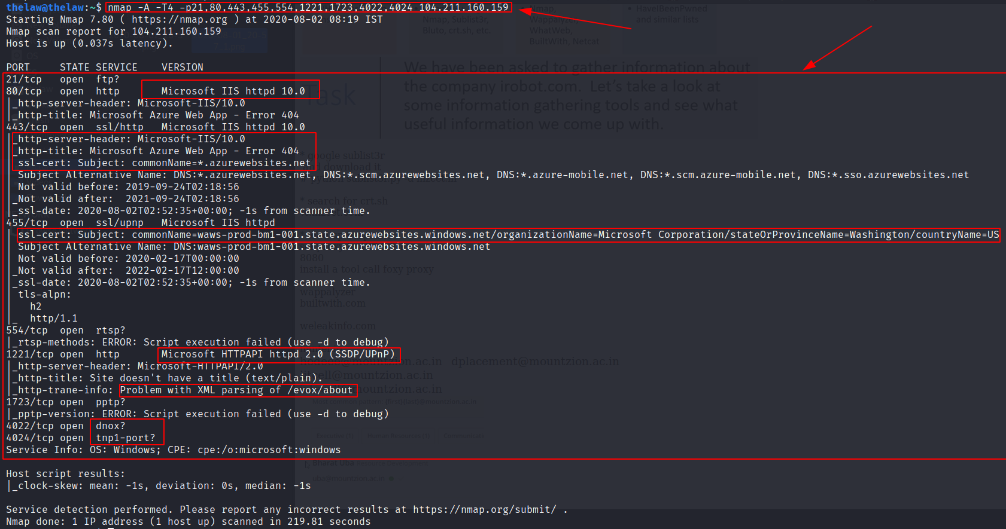
Hacking http://rnddev.azurewebsites.net/
Scanning and Enumeration
In-depth scanning of open ports using nmap tool:

Slide 35
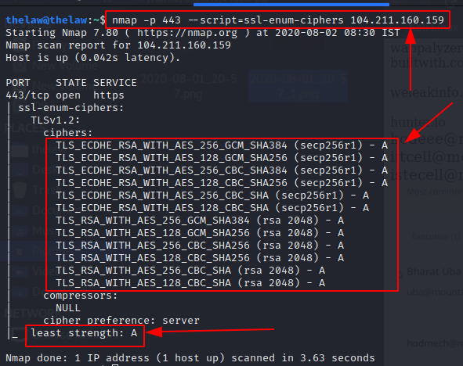
Hacking http://rnddev.azurewebsites.net/
Scanning and Enumeration
Checking the strength of ciphers nmap tool: (Ciphers are strong)

Slide 36
Hacking http://rnddev.azurewebsites.net/
Scanning and Enumeration
Checking the strength of ciphers nmap tool: (Ciphers are strong)

Slide 37
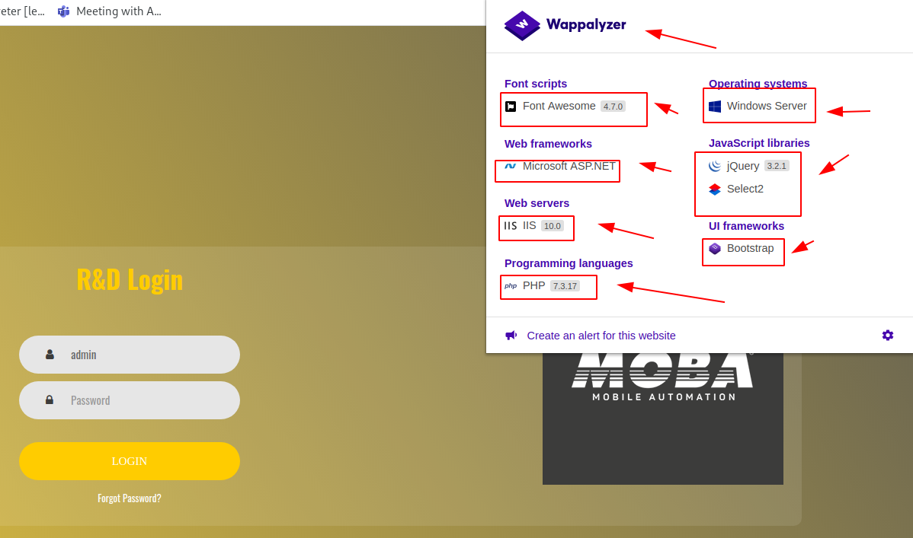
Hacking http://rnddev.azurewebsites.net/
Scanning and Enumeration
Details of the website using Wappalyzer

Slide 38
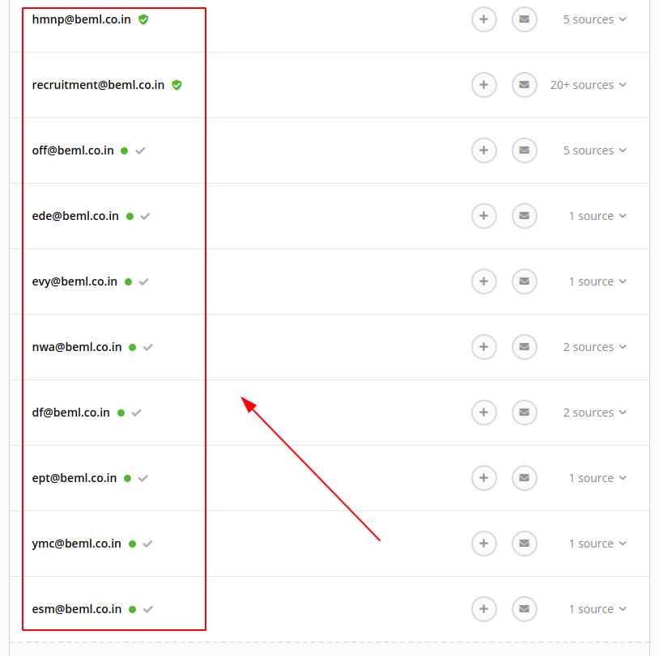
Hacking http://rnddev.azurewebsites.net/
Scanning and Enumeration
Found email addresses related to beml.co.in using hunter.io tool

Slide 39
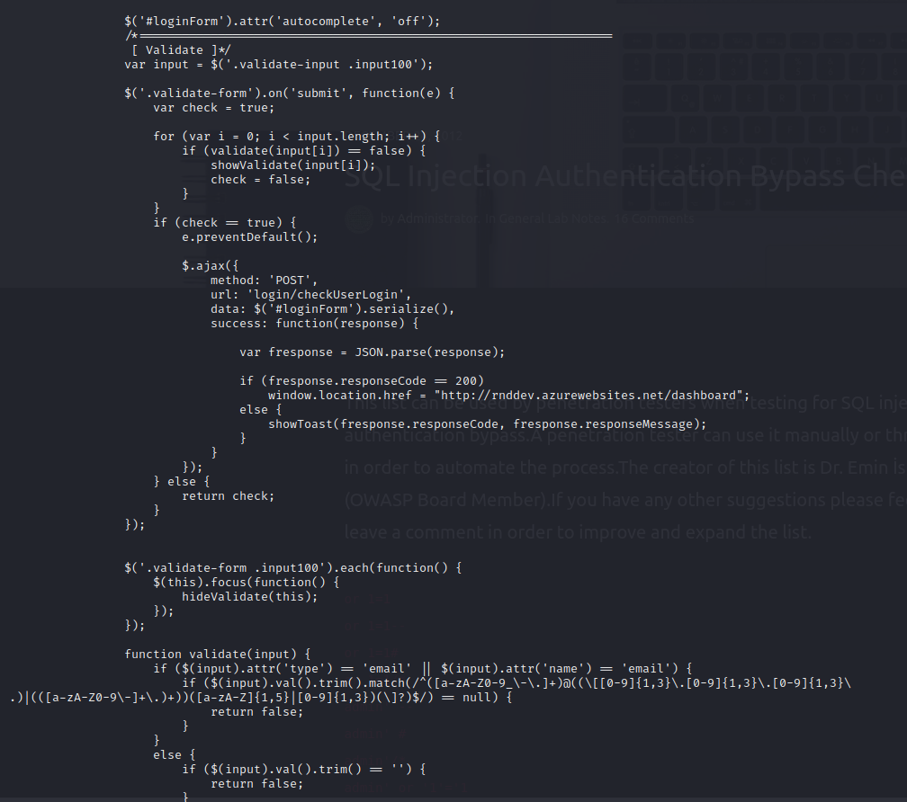
Hacking http://rnddev.azurewebsites.net/
Scanning and Enumeration
Found email addresses related to beml.co.in using hunter.io tool

Slide 40
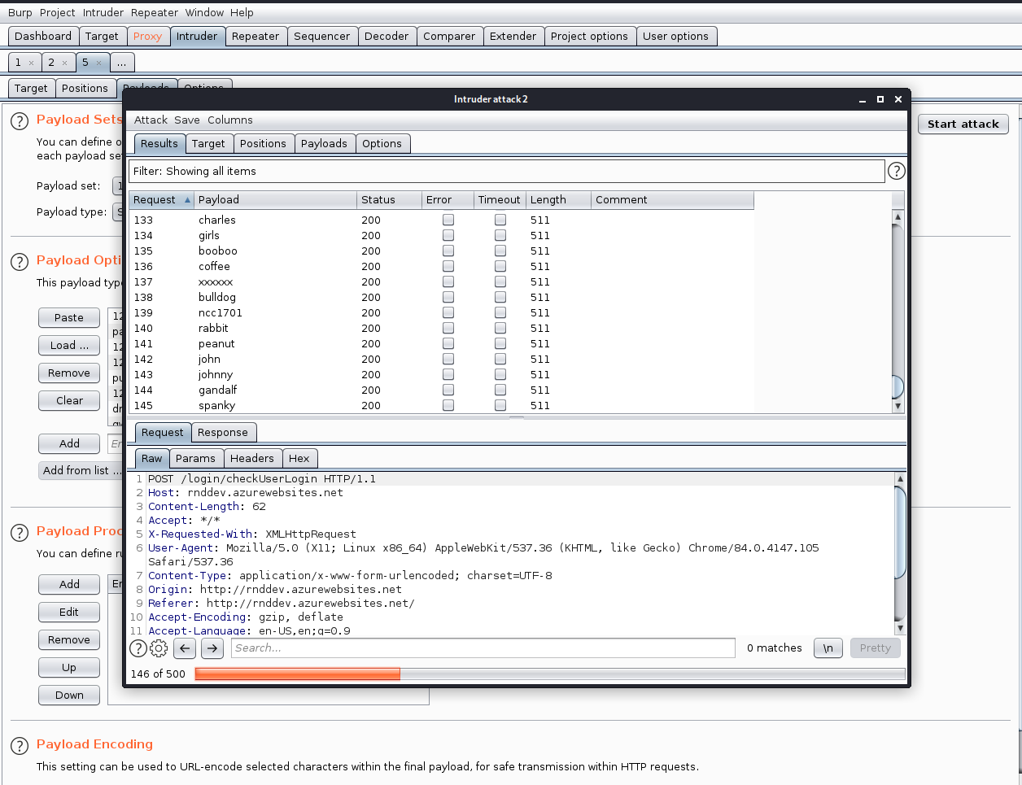
Hacking http://rnddev.azurewebsites.net/
Exploitation
Sniper Attack using BurpSuit:

Slide 41
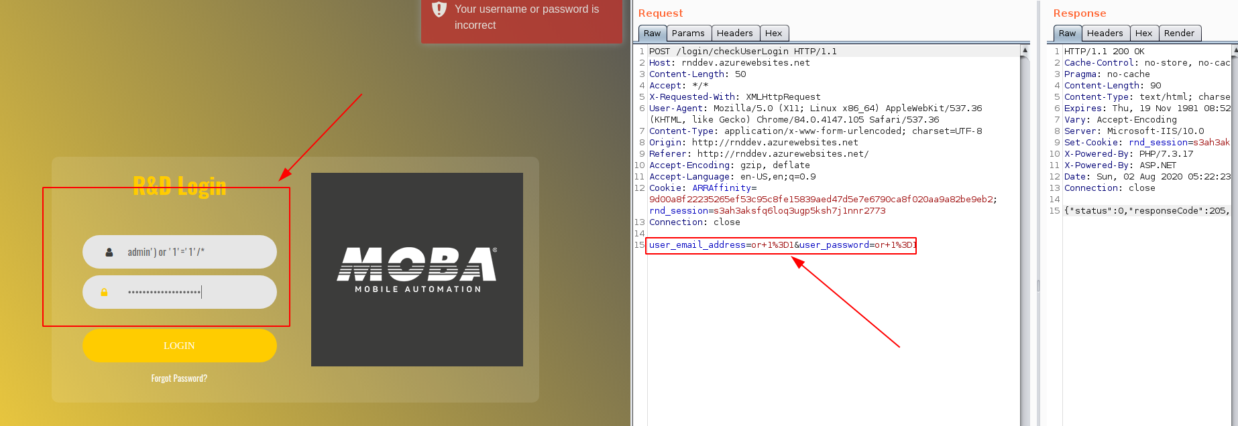
Hacking http://rnddev.azurewebsites.net/
Exploitation
SQL Injection

Slide 42
Hacking http://rnddev.azurewebsites.net/
Exploitation
Further Exploitation Plans
Brute Force Attack
URL Injection
Directory Traversal
SQL Injection via AJAX request with JSON response

Slide 44
BH60M & BH100 with Electronic Transmission
Securing the CAN J1939 2.0B Communication Protocol, to make RIDES SAFER!

Slide 45
NETWORK SEGMENTATION
SEGREGATE EACH NODES:
R&S
R&S
R&S

Slide 46
SWITCH
Data packets is directed to only the intended destination port.
Data packets arrives the switch.
Match the ports by MAC address.
Reduces unnecessary traffic.
Can detect any frame and keeps the record of MAC address

Slide 47
ROUTER
Receives data packets by the IP address.
Determines whether the packet is meant for own network.
Receives the own data.
Only allows the intended data packets to the network.
False data will be rejected by the router.

Slide 48
EXCHANGE DATA BETWEEN DIFFERENT NODES
Data packets has to leave the node and search for what node is meant for that.
To find that it will reach the router.
Router checks for the IP and forward it to the next router if it is not the destination.
Switches create network and router connects the network.

Slide 49
THANK YOU

Slide 51
BH60M & BH100 with Electronic Transmission
Securing the CAN J1939 2.0B Communication Protocol, to make RIDES SAFER!

Slide 52
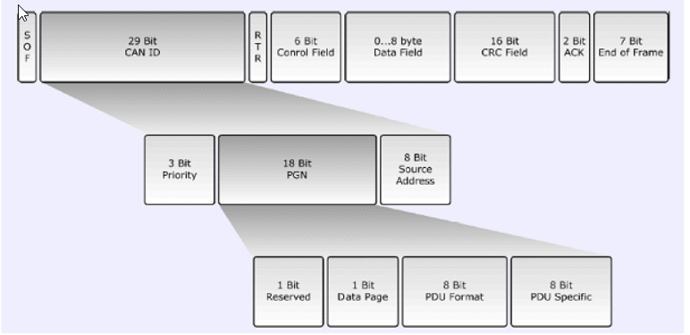
Understanding J1939 Frame

Slide 53
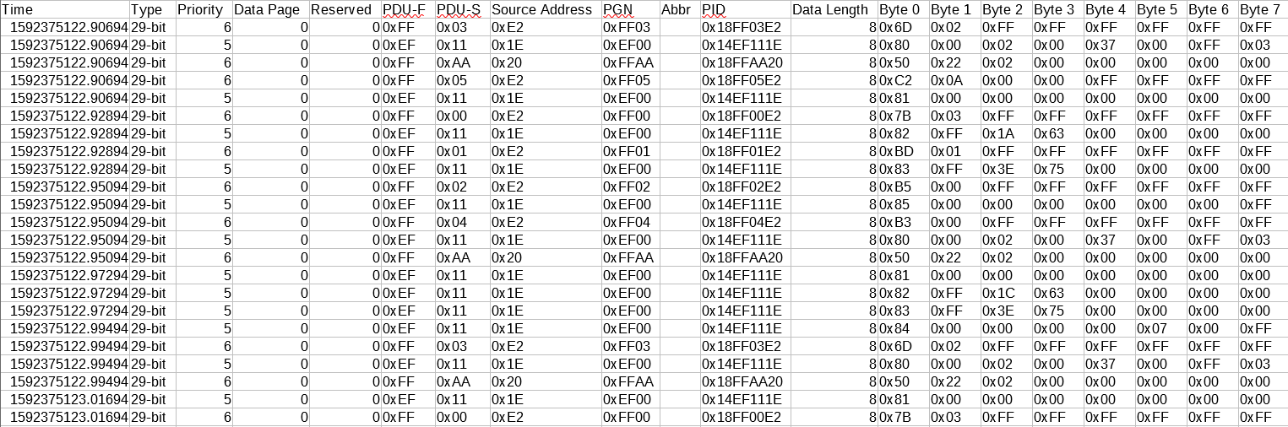
Understanding the Data in hand

Slide 54
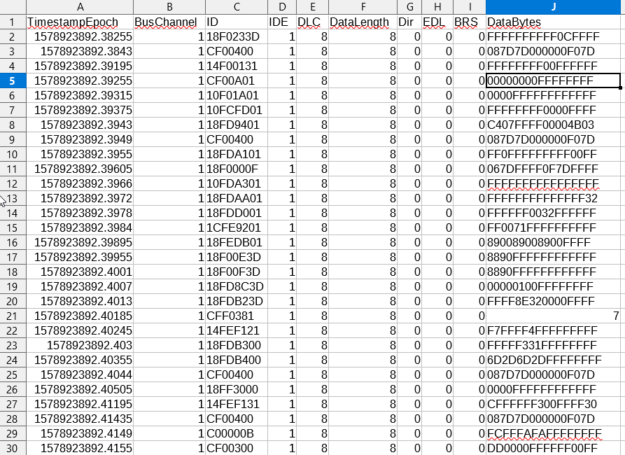
Converting my old CAN J1939 .mdf file to CSV file

Slide 55
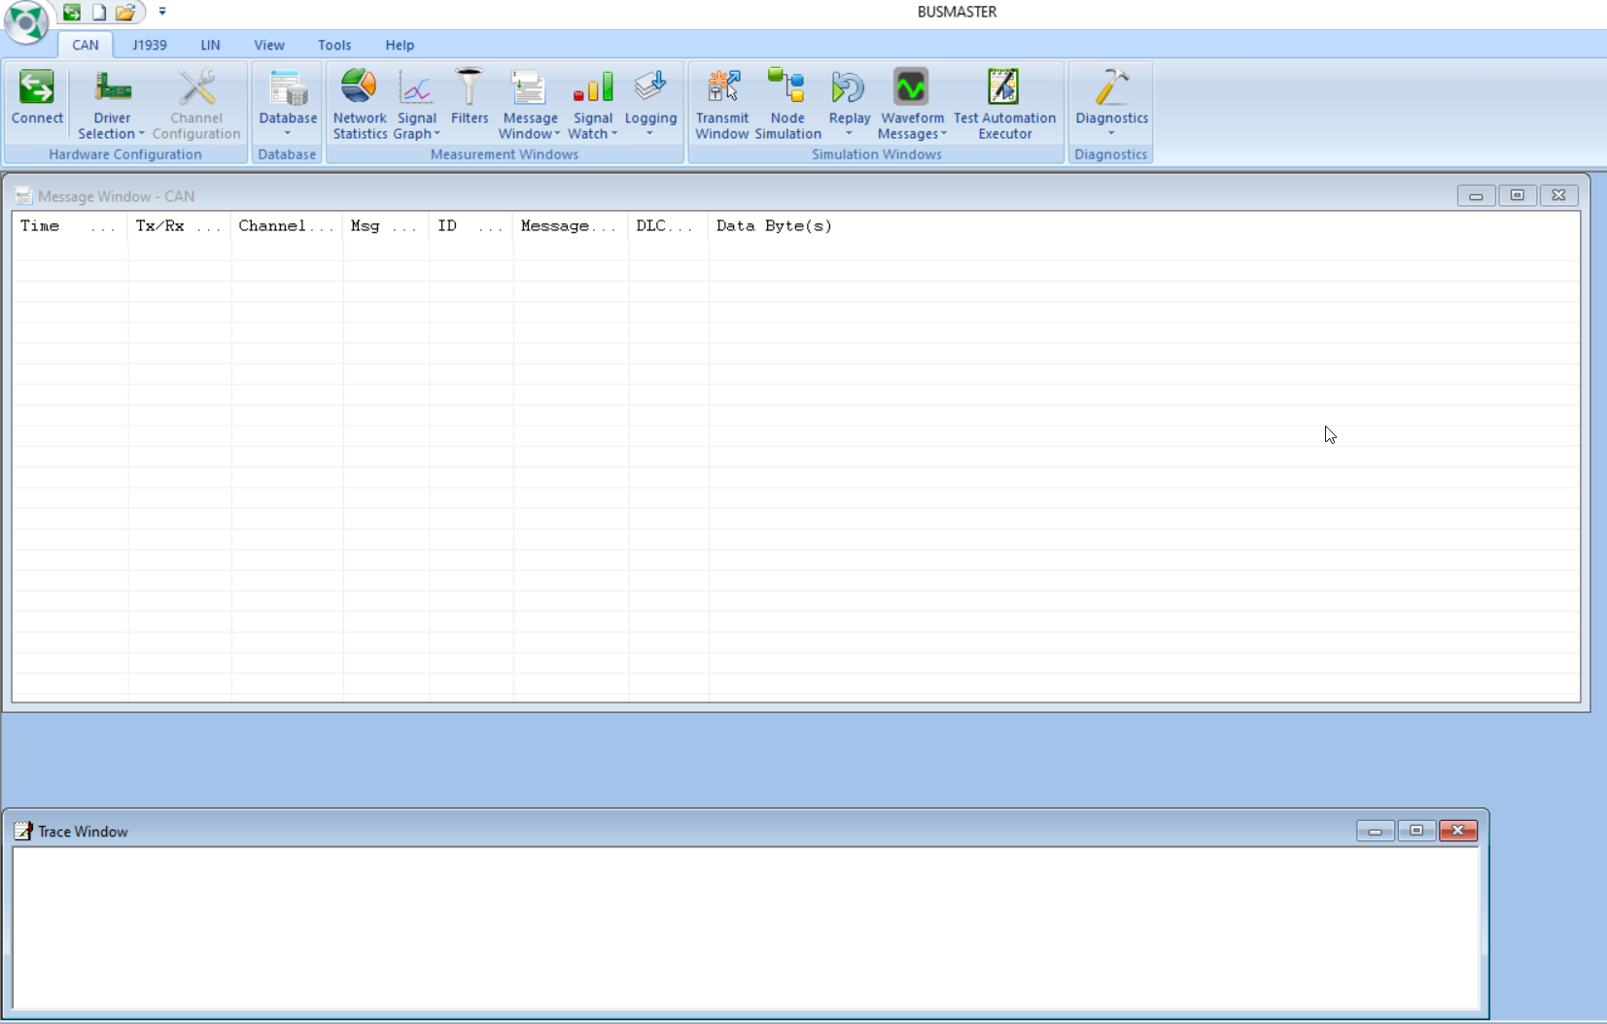
Further plan to create own DBC and CAN J1939 data using BusMaster

